Slide 1

Modeling Lens Effects Using MATLAB
By Andrew Katz
Instructor: Nicholas Dwork
Stanford Pre-Collegiate Summer Institutes 2015

Slide 2
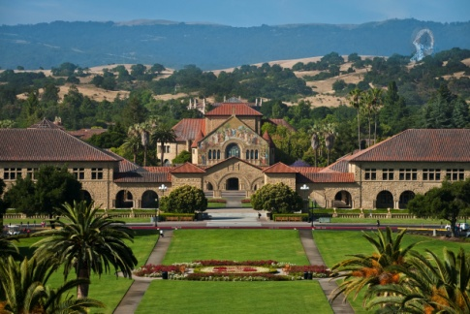
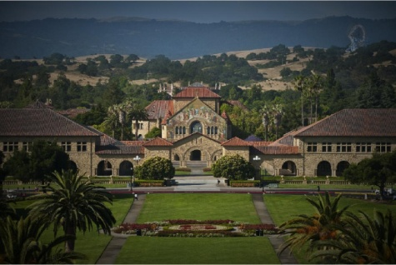
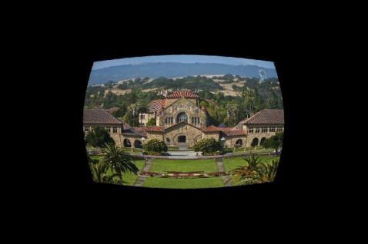
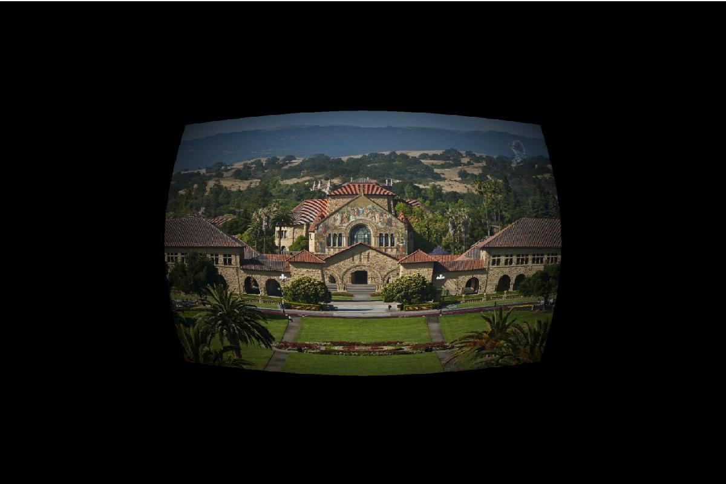
Applying Lens Effects
Effects can be applied to images once they are transformed into matrices using functions of pixel location.
These effects only apply to a single color, so an effect must be applied three times, for full color.
Figure 1
Figure 2
Figure 3
Figure 4
Figure 1 is the original image, before any effects were applied. Figure 2 shows a vignette applied. Figure 3 shows radial distortion applied, and figure 4 shows a vignette and radial distortion applied.

Slide 3
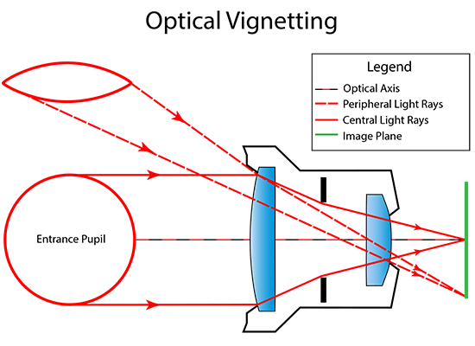
Vignettes
A vignette occurs because imperfect lenses refract differently towards the edge, and less light reaches a pixel in the center.^{[1]}
A vignette can be modeled by cos⁴(θ)
A vignette may be simulated in computer graphics for animation, etc…
https://cdn.photographylife.com/wp-content/uploads/2013/10/Optical-Vignetting.png

Slide 4
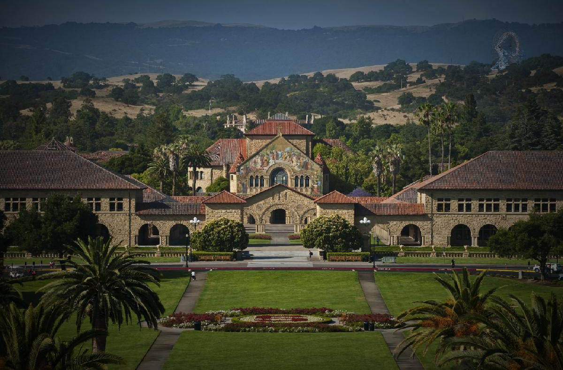

Vignetting
Vignetting simulated with cos⁴(θ)
A real vignette due to an imperfect lens

Slide 5
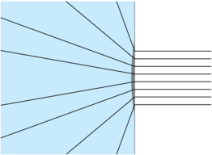
Radial Distortion
Radial Distortion occurs as a lens artifact, due to a fish eye lens, or some kinds of zoom lenses^{[2]}
Radial Distortion can be modeled with a Taylor Series, a polynomial which as the degree increases, the function more closely matches the true, infinite series it models.^{[2],[3]}
http://i.stack.imgur.com/Y4cJx.png

Slide 6
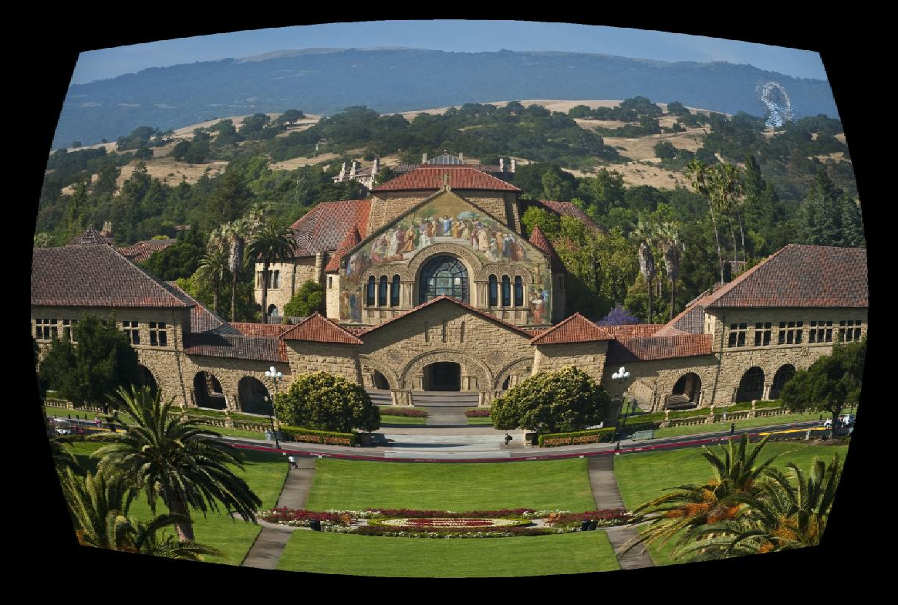
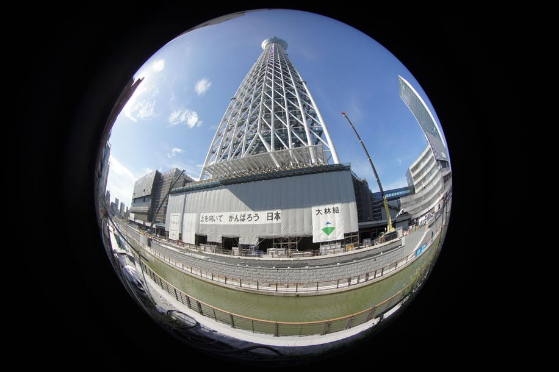
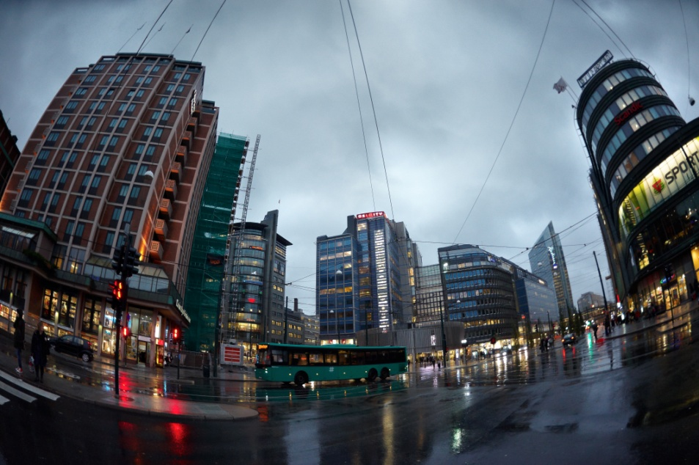
Radial Distortion (Fisheye)
Radial Distortion, applied using a forth order Taylor Series
Radial distortion caused by a fish eye lens

Slide 7
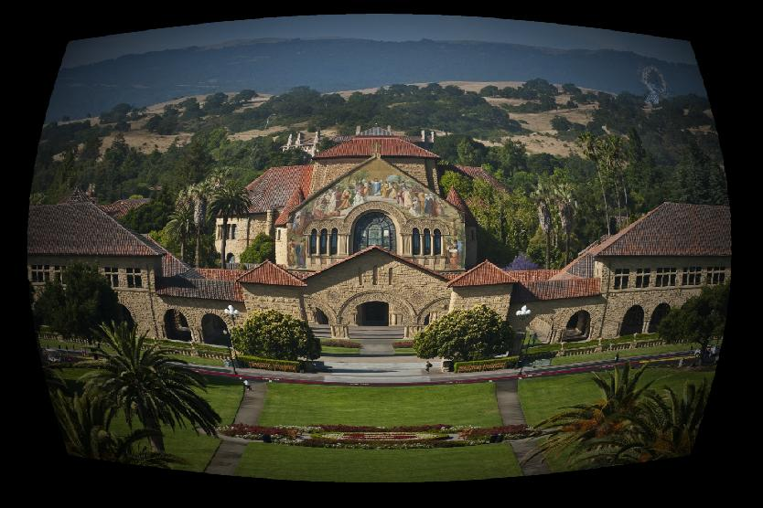
Radial Distortion and Vignetting
Multiple image effects can be applied to an image in series

Slide 8
References
https://en.wikipedia.org/wiki/Vignetting
https://en.wikipedia.org/wiki/Distortion_(optics)
https://en.wikipedia.org/wiki/Taylor_series
Code for this project is available at: https://github.com/aakatz3/SPCS2015FinalProject/

